Slide 1
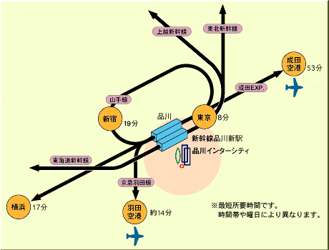
Title (Example 1)
M. S. Bahramy¹ , N. Nagaosa^{1,2}, and Y. Tokura^{1,2}
¹RIKEN Center for Emergent Matter Science (CEMS), Wako, Saitama 351-0198, Japan
²Department of Applied Physics, University of Tokyo, Tokyo 113-8656, Japan
The FIRST-QS2C Workshop on "Emergent Phenomena of Correlated Materials" will be held on Nov 13-16, 2013 at the Shinagawa Intercity Hall in Tokyo, Japan. This is the 14th workshop in a series held by JRCAT, AIST-CERC, ERATO, and RIKEN since 1996. This workshop aims at providing a forum to share the latest findings and ideas, as well as promoting international collaborations on emergent phenomena in correlated materials, with particular focus on the following subjects:
Emergent Topological Phenomena
Spintronics
Multiferroics
Interfaces and Oxide Electronics
New / Exotic Superconductors
To stimulate intensive discussions, the number of participants will be limited to approximately 300, including invited speakers. All presentations will be grouped into several themed sessions, each containing ample time for discussion.
[1] http://www.sicity.co.jp/a/index_a.html
Fig. 1 The access map of Shinagawa Intercity [1].

