Slide 1
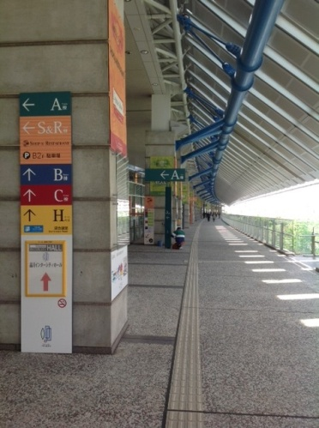
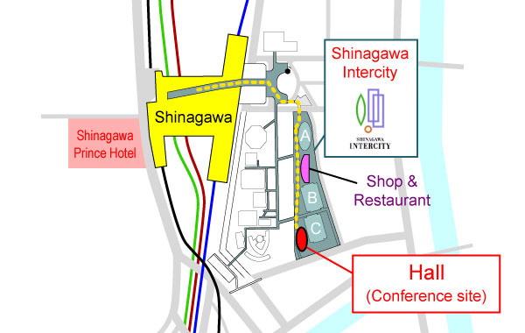
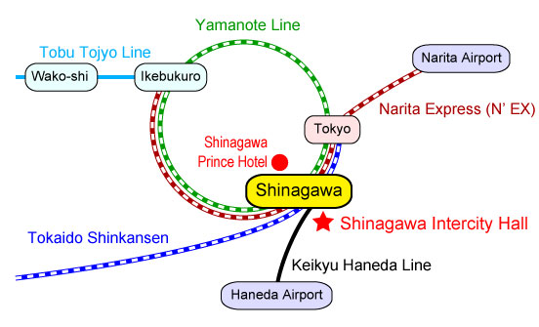
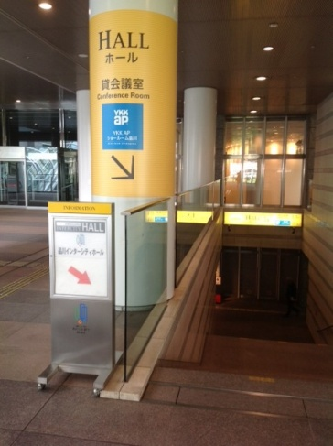
Title (Example 2)
N. Ogawa^{A}, and Y. Tokura^{A,B}
^{A}RIKEN CEMS, ^{B}University of Tokyo
TRANSPORTATION
WAY TO THE HALL
From Narita Airport (NRT) - Narita Express - Airport Limusine
- Taxi From Haneda Airport (HND)
- Keikyu Haneda Line
- Taxi.
The conference hall is 5 minutes walk from the Shinagawa station through the pedestrian road “Skyway”.
You can find the yellow guideboards along the way.
How to get to Shinagawa Intercity Hall.

